Slide 1
Cloud Computing
Module II

Slide 2
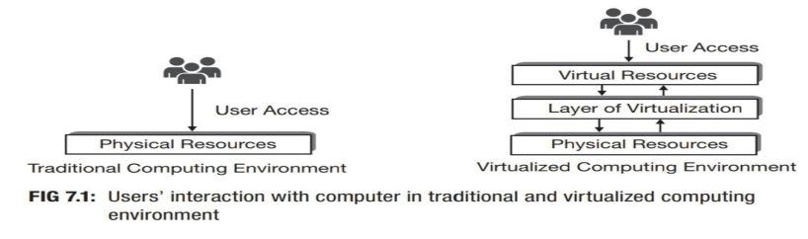
Virtualization
Virtualization refers to the representation of physical computing resources in simulated form having made through the software.
This special layer of software (installed over active physical machines) is referred as layer of virtualization.
This layer transforms the physical computing resources into virtual form which users use to satisfy their computing needs

Slide 3
The software for virtualization consists of a set of control programs.
It offers all of the physical computing resources in custom made simulated (virtual) form which users can utilize to build virtual computing setup or virtual computers or virtual machines (VM).
Users can install operating system over virtual computer just like they do it over physical computer.
Operating system installed over virtual computing environment is known as guest operating system.
When virtualization technique is in place, the guest OS executes as if it were running directly on the physical machine.

Slide 4
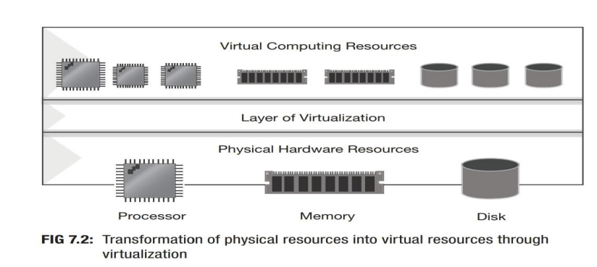

Slide 5
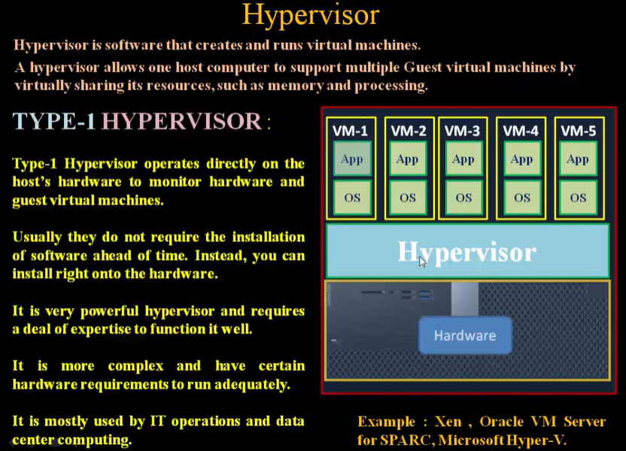

Slide 6
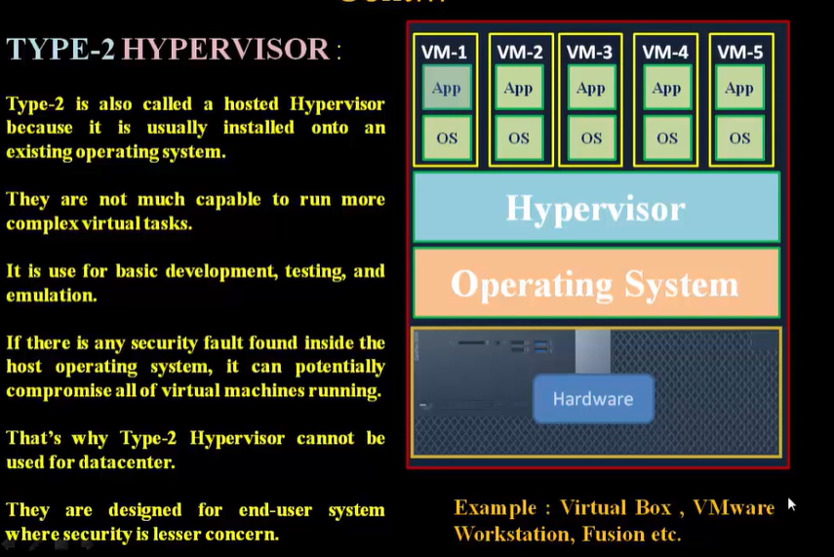

Slide 7
2.1 Levels of virtualization

Slide 8
2.1.1 Implementation levels of virtualization
Virtualization is a computer architecture technology by which multiple virtual machines (VMs) are multiplexed in the same hardware machine.
The purpose of a VM is to enhance resource sharing by many users and improve computer performance in terms of resource utilization and application flexibility.
Hardware resources (CPU, memory, I/O devices, etc.) or software resources (operating system and software libraries) can be virtualized in various functional layers
After virtualization, different user applications managed by their own operating systems (guest OS) can run on the same hardware, independent of the host OS.
This is often done by adding additional software, called a virtualization layer. This virtualization layer is known as hypervisor or virtual machine monitor (VMM)

Slide 9
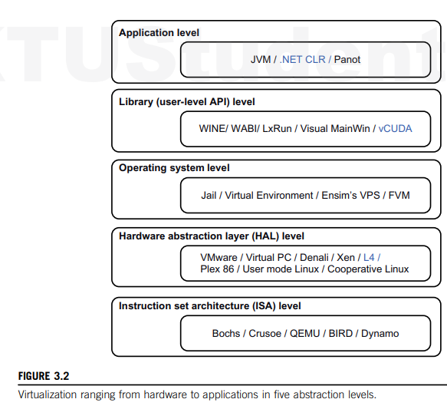
The main function of the software layer for virtualization is to virtualize the physical hardware of a host machine into virtual resources to be used by the VMs. This can be implemented at various operational levels.
Common virtualization layers include
Instruction set architecture (ISA) level
Hardware level
Operating system level
Library support level
Application level

Slide 10
2.1.1.1 Instruction Set Architecture Level
At the ISA level, virtualization is performed by emulating a given ISA by the ISA of the host machine.
The basic emulation method is through code interpretation.
An interpreter program interprets the source instructions to target instructions one by one.
One source instruction may require tens or hundreds of native target instructions to perform its function. Obviously, this process is relatively slow.
For better performance, dynamic binary translation is desired. This approach translates basic blocks of dynamic source instructions to target instructions
. The basic blocks can also be extended to program traces or superblocks to increase translation efficiency.
Instruction set emulation requires binary translation and optimization.
A virtual instruction set architecture (V-ISA) thus requires adding a processor-specific software translation layer to the compiler

Slide 11
2.1.1.2 Hardware Abstraction Level
Hardware-level virtualization is performed right on top of the bare hardware.
On the one hand, this approach generates a virtual hardware environment for a VM.
On the other hand, the process manages the underlying hardware through virtualization.
The idea is to virtualize a computer’s resources, such as its processors, memory, and I/O devices.
The intention is to upgrade the hardware utilization rate by multiple users concurrently.

Slide 12
2.1.1.3 Operating System Level
This refers to an abstraction layer between traditional OS and user applications.
OS-level virtualization creates isolated containers on a single physical server and the OS instances to utilize the hardware and software in data centers.
The containers behave like real servers.
OS-level virtualization is commonly used in creating virtual hosting environments to allocate hardware resources among a large number of mutually distrusting users.
It is also used, to a lesser extent, in consolidating server hardware by moving services on separate hosts into containers or VMs on one server.

Slide 13
2.1.1.4 Library Support Level
Virtualization with library interfaces is possible by controlling the communication link between applications and the rest of a system through API hooks.
The software tool WINE has implemented this approach to support Windows applications on top of UNIX hosts.
Another example is the vCUDA which allows applications executing within VMs to leverage GPU hardware acceleration.

Slide 14
2.1.1.5 User-Application Level
Application-level virtualization is also known as process-level virtualization.
The most popular approach is to deploy high level language (HLL) VMs.
In this scenario, the virtualization layer sits as an application program on top of the operating system, and the layer exports an abstraction of a VM that can run programs written and compiled to a particular abstract machine definition.
Any program written in the HLL and compiled for this VM will be able to run on it.
The Microsoft .NET CLR and Java Virtual Machine (JVM) are two good examples of this class of VM.
Other forms of application-level virtualization are known as application isolation, application sandboxing, or application streaming.
The process involves wrapping the application in a layer that is isolated from the host OS and other applications.
The result is an application that is much easier to distribute and remove from user workstations

Slide 15
2.1.2 VMM Design Requirements and Providers
Hardware-level virtualization inserts a layer between real hardware and traditional operating systems.
This layer is called the Virtual Machine Monitor (VMM) and manages a computing system's hardware resources.
Each time programs access the hardware the VMM captures the process. i.e. VMM acts as a traditional OS.
One hardware component, such as the CPU, can be virtualized as several virtual copies.
Therefore, several traditional operating systems which are the same or different can sit on the same set of hardware simultaneously

Slide 16
There are three requirements for a VMM:
VMM should provide an environment for programs which is essentially identical to the original machine.
Second, programs run in this environment should show, at worst, only minor decreases in speed.
Third, a VMM should be in complete control of the system resources.

Slide 17
Any program run under a VMM should exhibit a function identical to that which it runs on the original machine directly.
Two possible exceptions in terms of differences are permitted with this requirement:
differences caused by the availability of system resources
differences caused by timing dependencies.
The former arises when more than one VM is running on the same machine

Slide 18
Exceptions:
System Resource Availability:
Cause: This difference arises when multiple VMs are running on the same physical machine.
Explanation: When several VMs share the same hardware resources (CPU, memory, disk, network), the allocation of these resources can vary. For instance, if multiple VMs demand CPU time simultaneously, the VMM must distribute the CPU time among them. This can lead to situations where a VM gets fewer resources than it would on a dedicated machine, affecting the program's performance.
Timing Dependencies:
Cause: This difference arises due to how timing works within a virtualized environment.
Explanation: Programs often rely on specific timing to function correctly (e.g., waiting for a certain amount of time before proceeding to the next step). In a virtualized environment, the VMM might introduce variability in timing because it has to manage multiple VMs, causing delays or differences in timing. This can lead to slight variations in how a program executes, especially in time-sensitive operations.

Slide 19
The hardware resource requirements, such as memory, of each VM are reduced, but the sum of them is greater than that of the real machine installed.
The latter qualification is required because of the intervening level of software and the effect of any other VMs concurrently existing on the same hardware.
These two differences pertain to performance, while the function a VMM provides stays the same as that of a real machine.
A VMM should demonstrate efficiency in using the VMs. Compared with a physical machine, no one prefers a VMM if its efficiency is too low

Slide 20
Reduced Resource Requirements per VM:
Explanation: Each individual VM generally requires fewer hardware resources (like memory) compared to
running the same software on a physical machine. This is because VMMs can optimize and share resources efficiently among VMs.
Cumulative Resource Usage:
Explanation: Although each VM might need fewer resources individually, when you add up the resource requirements of all VMs running on the same hardware, the total can exceed the resources available on the physical machine. This happens because:
The VMM itself uses some resources to manage the VMs.
There might be inefficiencies or overhead associated with virtualization.
Multiple VMs running simultaneously can lead to higher total resource usage.
Impact of Concurrent VMs:
Explanation: The presence of multiple VMs running at the same time on the same hardware can affect performance. Each VM might experience delays or reduced performance due to competition for the same hardware resources (CPU, memory, etc.).

Slide 21
Complete control of these resources by a VMM includes the following aspects:
The VMM is responsible for allocating hardware resources for programs;
It is not possible for a program to access any resource not explicitly allocated to it;
It is possible under certain circumstances for a VMM to regain control of resources already allocated.
Not all processors satisfy these requirements for a VMM.

Slide 22
2.1.3 Virtualization Support at the OS Level
Operating system virtualization inserts a virtualization layer inside an operating system to partition a machine’s physical resources.
It enables multiple isolated VMs within a single operating system kernel.
This kind of VM is often called a virtual execution environment (VE), Virtual Private System (VPS), or simply container.
This means a VE has its own set of processes, file system, user accounts, network interfaces with IP addresses, routing tables, firewall rules, and other personal settings.
Although VEs can be customized for different people, they share the same operating system kernel. Therefore, OS-level virtualization is also called single-OS image virtualization

Slide 23
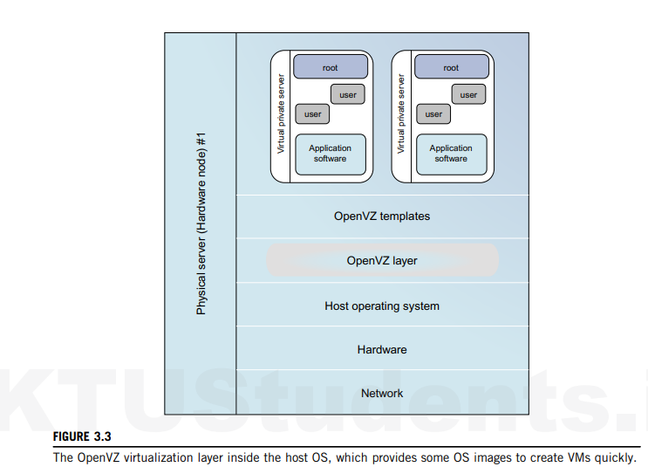

Slide 24
Advantages
Compared to hardware-level virtualization, the benefits of OS extensions are twofold:
VMs at the operating system level have minimal startup/shutdown costs, low resource requirements, and high scalability;
For an OS-level VM, it is possible for a VM and its host environment to synchronize state changes when necessary.
These benefits can be achieved via two mechanisms of OS-level virtualization:
All OS-level VMs on the same physical machine share a single operating system kernel;
The virtualization layer can be designed in a way that allows processes in VMs to access as many resources of the host machine as possible, but never to modify them.

Slide 25
Disadvantages of OS Extensions
The main disadvantage of OS extensions is that all the VMs at operating system level on a single container must have the same kind of guest operating system.
That is, although different OS-level VMs may have different operating system distributions, they must pertain to the same operating system family.
For example, a Windows distribution such as Windows XP cannot run on a Linux-based container

Slide 26
2.1.4 Middleware Support for Virtualization
Library-level virtualization is also known as user-level Application Binary Interface (ABI) or API emulation.
This type of virtualization can create execution environments for running alien programs on a platform rather than creating a VM to run the entire operating system

Slide 27
2.2 VIRTUALIZATION STRUCTURES/TOOLS AND MECHANISMS
Depending on the position of the virtualization layer, there are several classes of VM architectures, namely
The hypervisor architecture
Paravirtualization
Host-based virtualization

Slide 28
2.2.1 Hypervisor and Xen Architecture
The hypervisor supports hardware-level virtualization on bare metal devices like CPU, memory, disk and network interfaces.
The hypervisor software sits directly between the physical hardware and its OS. This virtualization layer is referred to as either the VMM or the hypervisor.
The hypervisor provides hypercalls for the guest OSes and applications.

Slide 29
The Xen Architecture
Xen is an open source hypervisor program developed by Cambridge University.
Xen is a microkernel hypervisor, which separates the policy from the mechanism.
The Xen hypervisor implements all the mechanisms, leaving the policy to be handled by Domain 0
The core components of a Xen system are the hypervisor, kernel, and applications.

Slide 30
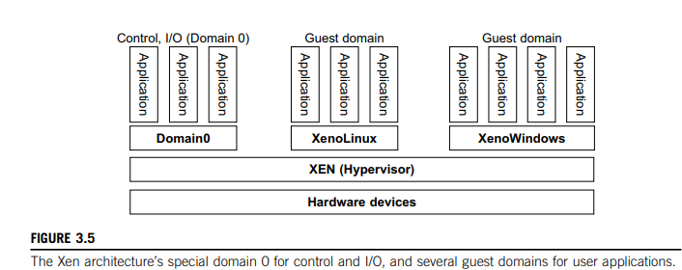

Slide 31
The guest OS, which has control ability, is called Domain 0, and the others are called Domain U.
Domain 0 is a privileged guest OS of Xen.
It is first loaded when Xen boots without any file system drivers being available.
Domain 0 is designed to access hardware directly and manage devices.
Therefore, one of the responsibilities of Domain 0 is to allocate and map hardware resources for the guest domains
Domain 0 has the privilege to manage other VMs implemented on the same host

Slide 32
2.2.1 Binary Translation with Full Virtualization
Depending on implementation technologies, hardware virtualization can be classified into two categories:
Full virtualization
Host-based virtualization.
Full virtualization does not need to modify the host OS. It relies on binary translation to trap and to virtualize the execution of certain sensitive, nonvirtualizable instructions. The guest OSes and their applications consist of noncritical and critical instructions.
In a host-based system, both host and guest OS are used. A virtualization software layer is built between the host OS and guest OS

Slide 33
Full Virtualization
In full virtualization, noncritical instructions run directly on the hardware for efficiency, while critical instructions are intercepted and emulated by the VMM to ensure proper execution.
Both hypervisors and VMMs are essential components of full virtualization, providing the necessary environment and management for virtual machines.

Slide 34
Why are only critical instructions trapped into the VMM?
This is because binary translation can incur a large performance overhead. Noncritical instructions do not control hardware or threaten the security of the system, but critical instructions do. Therefore, running noncritical instructions on hardware not only can promote efficiency, but also can ensure system security

Slide 35
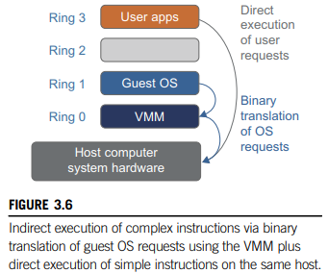
Binary Translation of Guest OS Requests Using a VMM
VMware’s full virtualization approach combines binary translation and direct execution to manage the execution of guest operating systems.
By placing the VMM at Ring 0 and the guest OS at Ring 1, VMware ensures that the VMM safely handles critical instructions, while non-critical instructions run directly on the hardware.
This allows the guest OS to run seamlessly without being aware of the virtualization

Slide 36
Host-Based Virtualization
In this architecture, a virtualization layer is installed on top of the host operating system (OS).
The host OS continues to manage the hardware resources.
Guest operating systems (guest OSes) are installed and run on top of this virtualization layer.
Dedicated applications can run on the virtual machines (VMs) created by the virtualization layer.
Other applications can still run directly on the host OS.

Slide 37
Advantages:
No Modification Needed: Users can install this VM architecture without modifying the host OS.
Simplified Design and Deployment: The virtualizing software relies on the host OS to provide device drivers and other low-level services, simplifying the VM design and making deployment easier.
Compatibility: This approach is compatible with many host machine configurations.
Performance Impact: Compared to the hypervisor/VMM architecture, the performance of the host-based architecture may be lower.
Layered Mapping: When an application requests hardware access, it involves four layers of mapping (application, guest OS, virtualization layer, host OS), which can significantly degrade performance.

Slide 38
Para-Virtualization with Compiler Support
Para-virtualization requires modifications to the guest operating system (OS).
Special APIs are provided, which necessitate substantial changes in the OS and user applications.
Performance degradation is a critical issue in virtualized systems.
Para-virtualization aims to reduce the overhead associated with virtualization, thereby improving performance by modifying only the guest OS kernel.
In para-virtualization, VMM layer is typically placed between the hardware and the OS.

Slide 39
Para-Virtualization Architecture
The x86 processor architecture has four rings (0 to 3) that define privilege levels.
Ring 0: Highest privilege level, where the OS kernel runs.
Ring 3: Lowest privilege level, where user-level applications run.
The virtualization layer is installed at Ring 0, which can cause issues if different instructions at Ring 0 conflict.
An intelligent compiler assists in replacing non-virtualizable instructions with hypercalls.
This ensures that the guest OS can communicate effectively with the hypervisor.

Slide 40
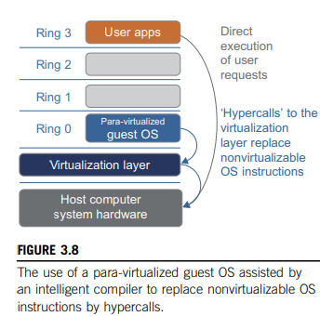

Slide 41
VIRTUALIZATION OF CPU, MEMORY, AND I/O DEVICES
Hardware Virtualization
To support virtualization, processors such as the x86 employ a special running mode and instructions, known as hardware-assisted virtualization.
Modern operating systems and processors allow multiple processes to run simultaneously.
Without protection mechanisms, instructions from different processes could access hardware directly, potentially causing system crashes.
For running user-level applications with limited access to hardware we have user mode.
For running the OS kernel with full access to hardware (also known as privileged mode) we use Supervisor Mode.

Slide 42
Hardware-assisted virtualization uses special processor modes and instructions to support virtualization efficiently.
The VMM and guest OS run in different modes, with sensitive instructions trapped by the VMM.
Mode switching is handled by the hardware, and companies like Intel and AMD provide proprietary technologies for this purpose.
Modern processors have user and supervisor modes to ensure controlled access to hardware, with privileged instructions running in supervisor mode.
Hardware-assisted virtualization helps manage the complexity of virtualized environments by providing efficient support for virtualization tasks

Slide 43
CPU Virtualization
A VM duplicates an existing computer system, with most instructions running directly on the host processor for efficiency.
Critical instructions are categorized into privileged, control-sensitive, and behavior-sensitive instructions, which are handled by the VMM to ensure system stability.
A CPU architecture is virtualizable if it supports running VM instructions in user mode while the VMM runs in supervisor mode. RISC architectures are naturally virtualizable, while x86 architectures have limitations.
In UNIX-like systems, system calls are handled by triggering interrupts that pass control to the OS kernel.

Slide 44
Memory Virtualization
In virtual memory virtualization, the traditional one-stage mapping of virtual memory to physical memory is extended to a two-stage mapping process in a virtualized environment.
The guest OS manages the first stage (virtual memory to physical memory), while the VMM manages the second stage (physical memory to machine memory).
MMU virtualization supports this process, ensuring that the guest OS can operate without being aware of the underlying complexity.
This allows efficient sharing and dynamic allocation of physical system memory among multiple VMs.

Slide 45
I\O Virtualization
I/O virtualization involves managing the routing of input/output (I/O) requests between virtual devices and the shared physical hardware. This allows multiple virtual machines (VMs) to share the same physical I/O devices (like network cards, storage devices, etc.) efficiently.

Slide 46
Three Ways to Implement I/O Virtualization
Full Device Emulation:
Description: This approach emulates well-known, real-world devices.
How It Works: The virtual machine monitor (VMM) or hypervisor creates a virtual version of a physical device. The guest OS interacts with this virtual device as if it were a real one.
Advantages: Compatibility with a wide range of guest operating systems and applications, as they see familiar devices.
Disadvantages: Can be slower due to the overhead of emulating the device.
Para-Virtualization:
Description: This approach requires modifications to the guest OS to be aware of the virtual environment.
How It Works: The guest OS uses special APIs to interact with the VMM, bypassing some of the overhead associated with full device emulation.
Advantages: Improved performance compared to full device emulation because it reduces the overhead.
Disadvantages: Requires changes to the guest OS, which may not always be possible or desirable.
Direct I/O:
Description: This approach allows the guest OS to access physical devices directly.
How It Works: The VMM provides a direct path to the physical device, minimizing the overhead.
Advantages: Highest performance since it eliminates most of the virtualization overhead.
Disadvantages: More complex to implement and may require specific hardware support.

Slide 47
Why is hypervisor also called virtual machine monitor?
Hypervisor produces all of the virtual computing resources. Virtual machines are created over the layer of hypervisor using these virtual resources. It is the responsibility of the hypervisor to manage activities, monitor functionalities and provide support to the virtual machines. This is why hypervisor is also called as virtual machine monitor or VMM

Slide 48
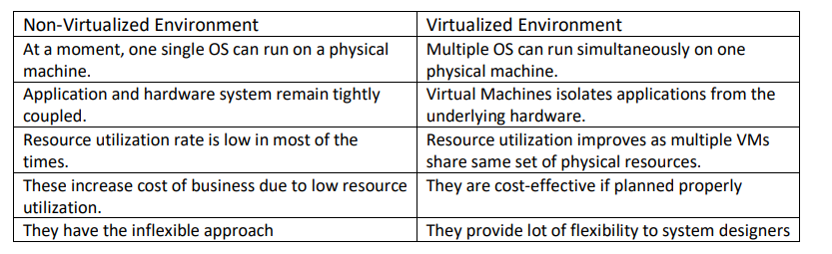
State the differences between a traditional computer and a virtual machine

